Slide 1
Structures in C

Slide 2
Structure examples
#include<stdio.h>
struct complex{int a;
int b;};
int main()
{
struct complex c1, c2;
struct complex *c3, *c4;
printf("\n enter real and imaginary parts of c1 and c2 \n");
scanf("%d %d %d %d", &c1.a,&c1.b, &c2.a,&c2.b);
printf("\n print c1 =%d + %d i, c2 = %d + %d i \n", c1.a,c1.b,c2.a,c2.b);
return 0;
}

Slide 3
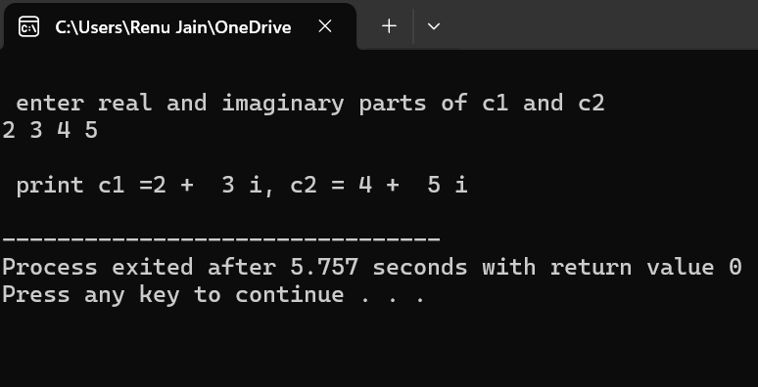
Complex numbers
read and write two complex numbers
Output
#include<stdio.h>
struct complex{int a;
int b;};
int main()
{
struct complex c1, c2;
struct complex *c3, *c4;
printf("\n enter real and imaginary parts of c1 and c2 \n");
scanf("%d %d %d %d", &c1.a,&c1.b, &c2.a,&c2.b);
printf("\n print c1 =%d + %d i, c2 = %d + %d i \n", c1.a,c1.b,c2.a,c2.b);
return 0;
}

Slide 4
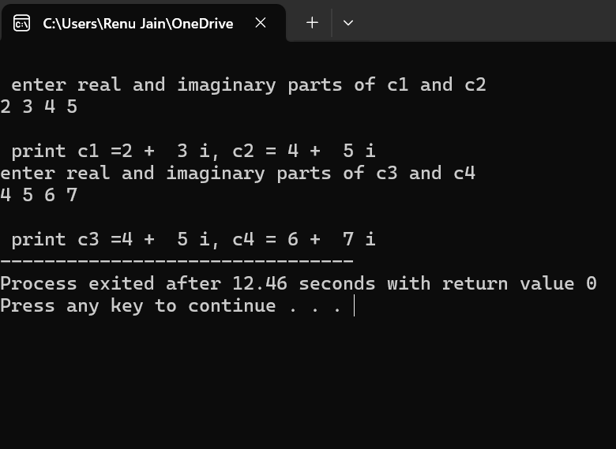
Dynamic allocation of memory
#include<stdio.h>
#include<stdlib.h>
struct complex{int a;
int b;};
int main()
{
struct complex c1, c2;
struct complex *c3, *c4;
printf("\n enter real and imaginary parts of c1 and c2 \n");
scanf("%d %d %d %d", &c1.a,&c1.b, &c2.a,&c2.b);
printf("\n print c1 =%d + %d i, c2 = %d + %d i \n", c1.a,c1.b,c2.a,c2.b);
c3 = (struct complex*)malloc (sizeof(struct complex));
c4 = (struct complex*)malloc (sizeof(struct complex));
printf("enter real and imaginary parts of c3 and c4 \n");
scanf("%d %d %d %d", &c3->a,&c3->b, &c4->a,&c4->b);
printf("\n print c3 =%d + %d i, c4 = %d + %d i ", c3->a,c3->b,c4->a,c4->b);
return 0;
}

Slide 5
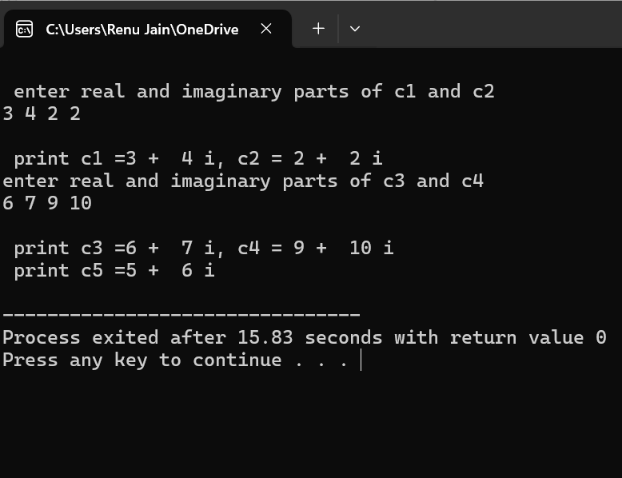
include<stdio.h>
#include<stdlib.h>
struct complex{int a; int b;};
struct complex add(struct complex, struct complex);
int main() struct complex c1, c2, c5; struct complex *c3, *c4;
printf("\n enter real and imaginary parts of c1 and c2 \n");
scanf("%d %d %d %d", &c1.a,&c1.b, &c2.a,&c2.b);
printf("\n print c1 =%d + %d i, c2 = %d + %d i \n", c1.a,c1.b,c2.a,c2.b);
c3 = (struct complex*)malloc (sizeof(struct complex));
c4 = (struct complex*)malloc (sizeof(struct complex));
printf("enter real and imaginary parts of c3 and c4 \n");
scanf("%d %d %d %d", &c3->a,&c3->b, &c4->a,&c4->b);
printf("\n print c3 =%d + %d i, c4 = %d + %d i ", c3->a,c3->b,c4->a,c4->b);
c5 = add(c1,c2);
printf("\n print c5 =%d + %d i \n", c5.a,c5.b); return 0;}
struct complex add(struct complex c1, struct complex c2)
{struct complex c3;
c3.a = c1.a +c2.a;
c3.b = c1.b +c2.b;
return(c3);}

Slide 6
Array of structures
struct student { int rollno;
char name[20];
float gd_point[5];
};
Three ways of declaring:
Struct student s1;
Struct student *s1;
Struct student s1[5];

Slide 7
#include<stdio.h>
#include<stdlib.h>
struct student{int rollno; char name[20]; float gd_point[5];};
float avg_point(struct student);
int main(){
struct student c1, s[5], *c2;
float avg;
printf("\n enter roll no, name and 5 grade points for one student in c1 \n");
scanf("%d %s", &c1.rollno,c1.name);
printf("\n print student c1 rollno =%d, name = %s\n", c1.rollno, c1.name);
for(int i=0;i<5;i++)
{scanf("%f", &c1.gd_point[i]);
printf("\n gd_point[ %d ]= %f\n", i, c1.gd_point[i]);
}

Slide 8
avg = avg_point(c1);
printf("\n average grad point of c1 student = %f\n", avg);
for(int i=0;i<5;i++)
{printf("\n enter roll no, name and 5 grade points for each s[i], i= %d \n", i);
scanf("%d %s", &s[i].rollno,s[i].name);
printf("\n student s[ %d] rollno =%d, name = %s\n", i, s[i].rollno,s[i].name);
for(int j=0;j<5;j++)
{scanf("%f", &s[i].gd_point[j]);
printf("\n gd_point[ %d ]= %f\n", j, s[i].gd_point[j]);
}
}
return 0;
}

Slide 9
float avg_point(struct student s)
{ float avg, sum=0;
for(int i=0;i<5;i++)
sum = sum + s.gd_point[i];
avg = sum/5;
return avg;
}

Slide 10
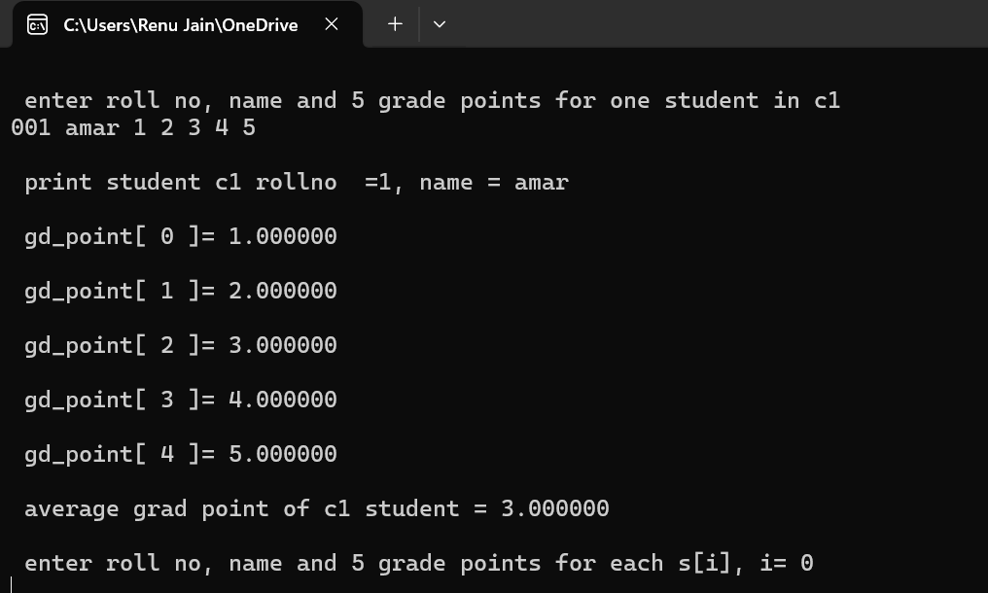
Output

Slide 11
Dynamic allocation
#include<stdio.h>
#include<stdlib.h>
struct student{int rollno; char name[20]; float gd_point[5];};
float avg_point(struct student);
int main(){
struct student *c2; float avg;
c2 = (struct student* )malloc(sizeof(struct student));
printf("\n enter roll no, name and 5 grade points for one student in c2 \n");
scanf("%d %s", &c2->rollno,c2->name);
printf("\n print student c2 rollno = %d, name = %s\n", c2->rollno,c2->name);
for(int i=0;i<5;i++)
{scanf("%f", &c2->gd_point[i]);
printf("\n gd_point[ %d ]= %f\n", i, c2->gd_point[i]); }
avg = avg_point(*c2); printf("\n average grad point of c2 student = %f\n", avg);
return 0;
}

Slide 12
float avg_point(struct student s)
{ float avg, sum=0;
for(int i=0;i<5;i++)
sum = sum + s.gd_point[i];
avg = sum/5;
return avg;
}

Slide 13
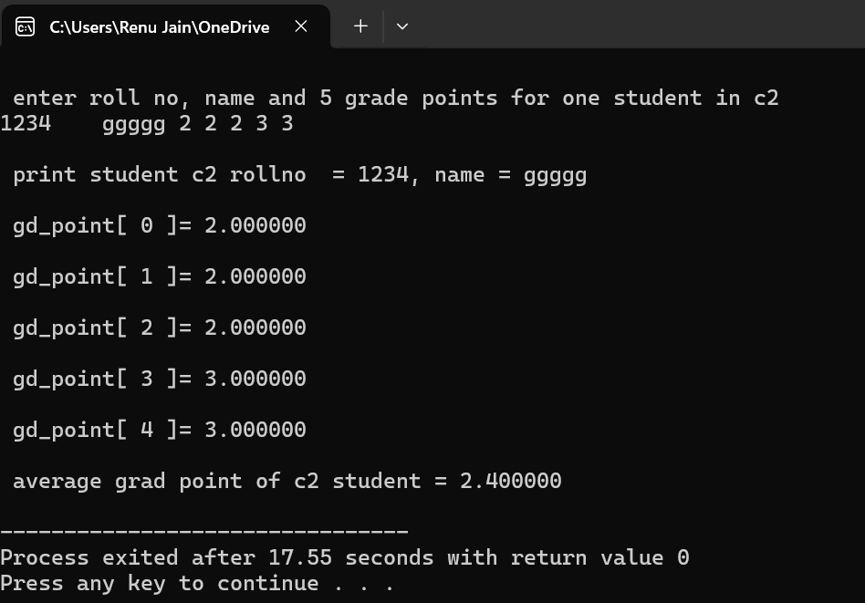
Output

